Slide 1

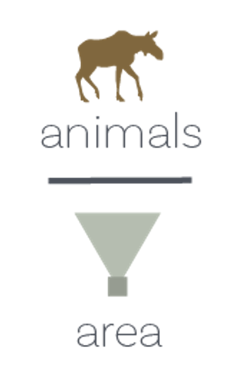

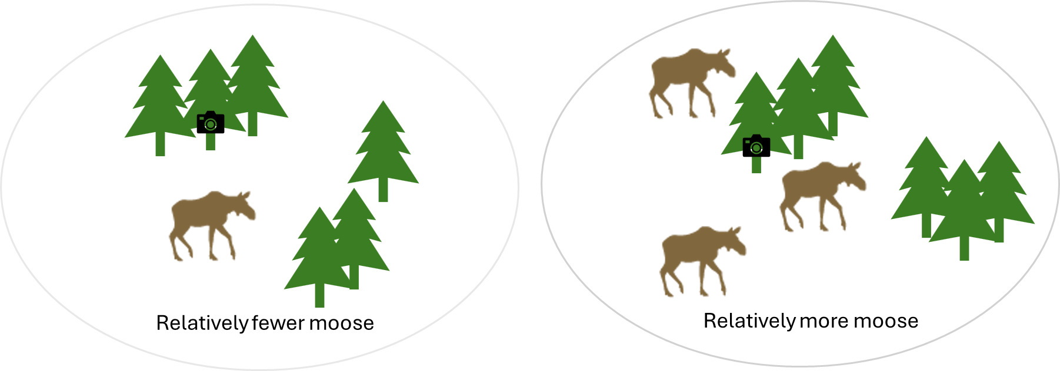
Relatively fewer moose
Relatively more moose

Slide 2
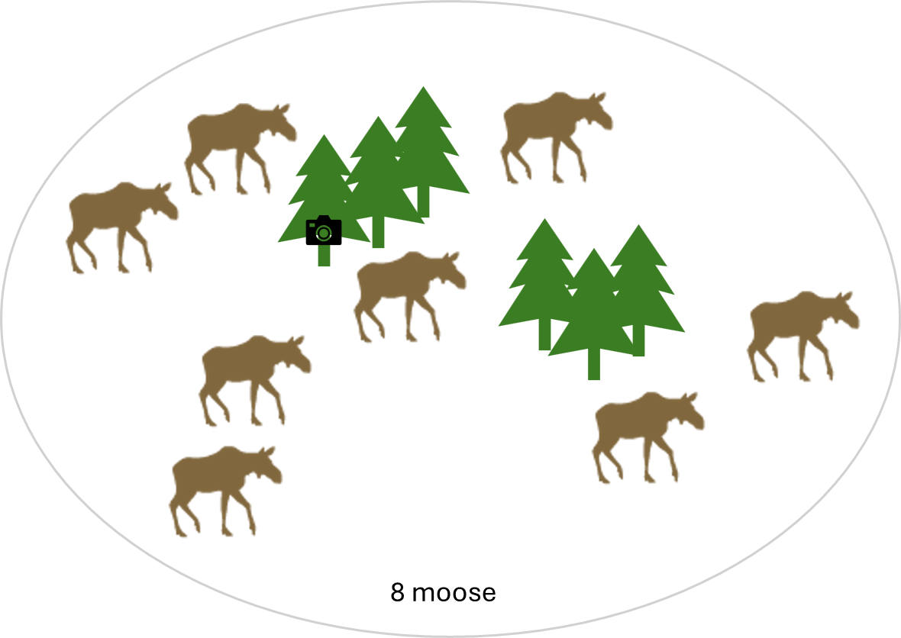
8 moose

Slide 3
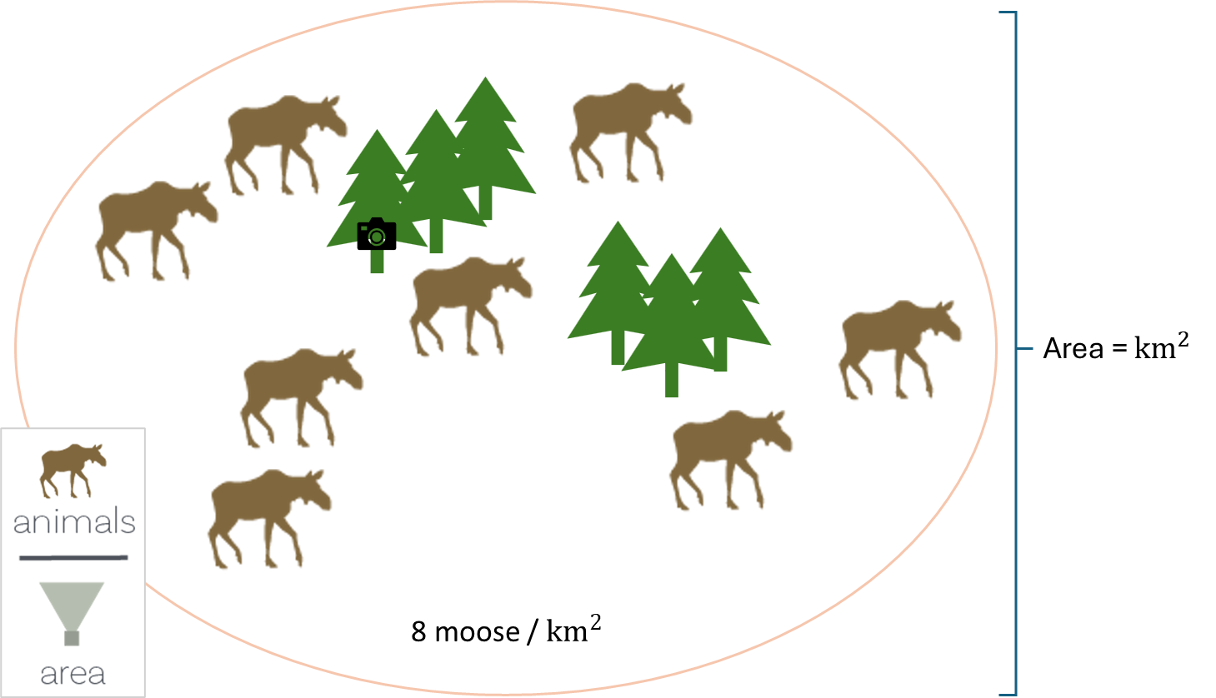
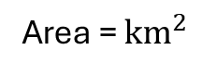
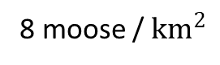
Area = ${km}^{2}$
8 moose / ${km}^{2}$

Slide 4
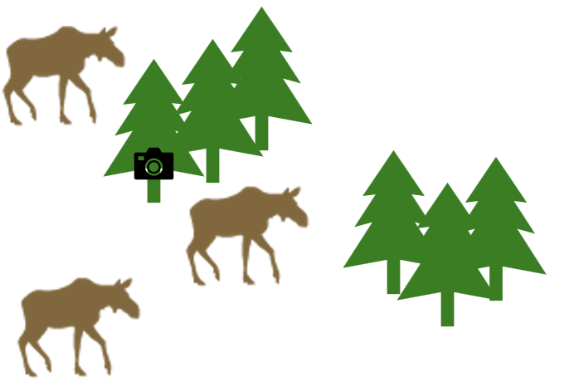

Slide 5
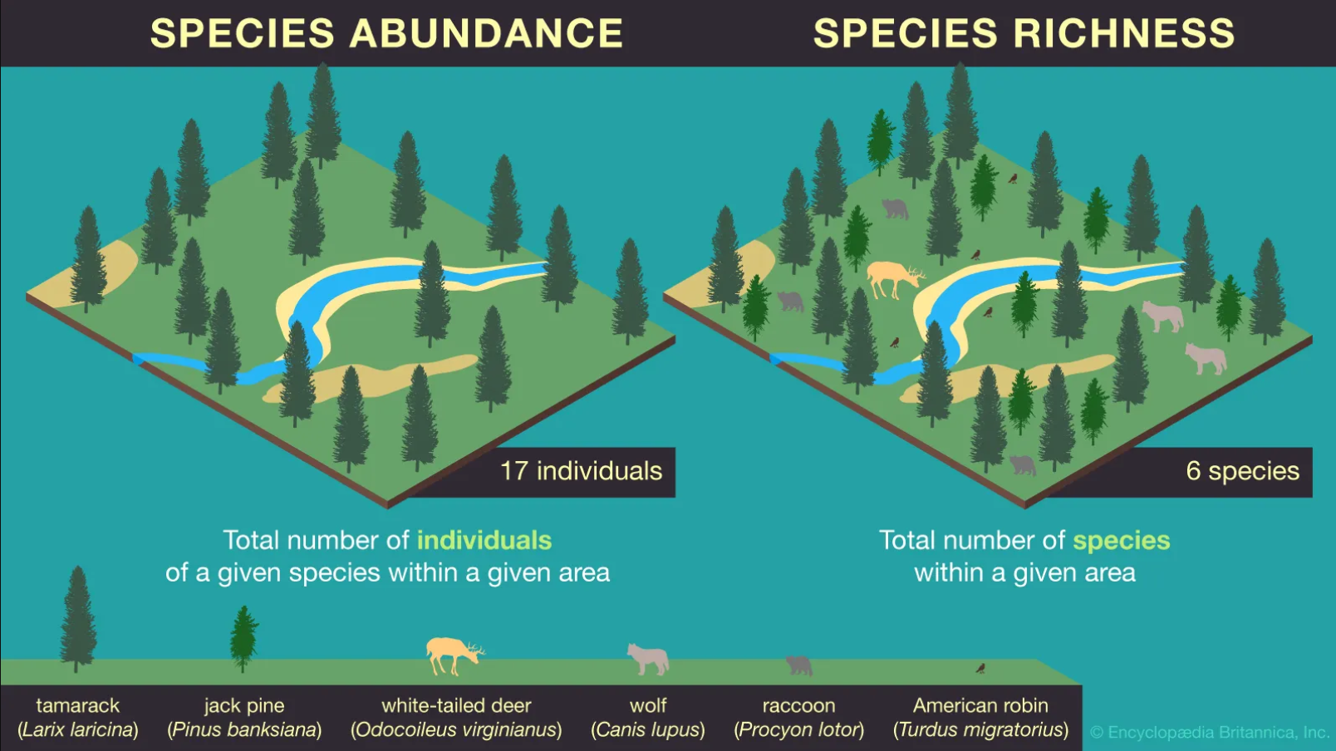
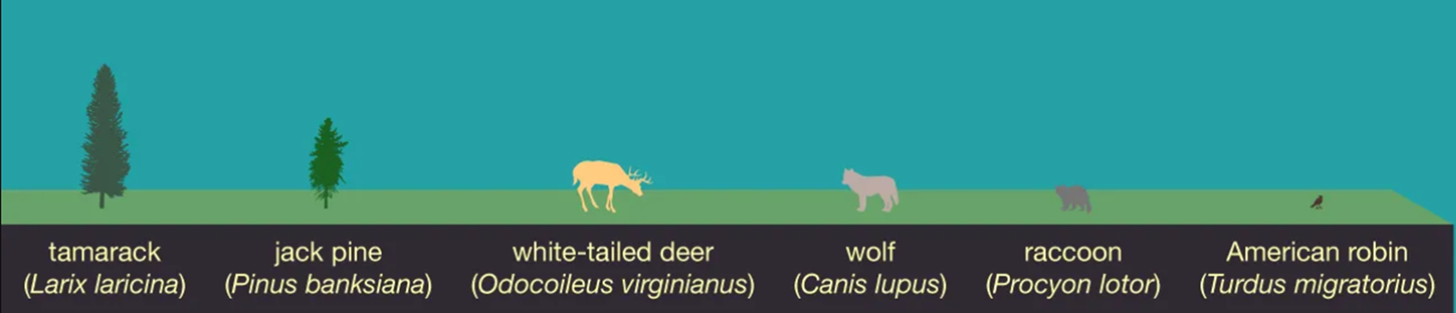

Slide 7

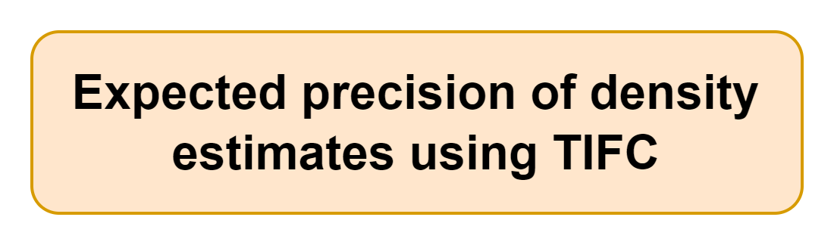

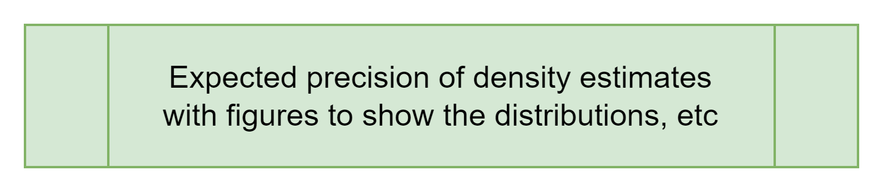
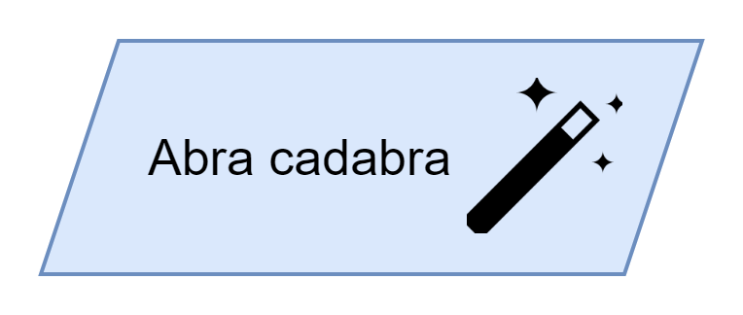
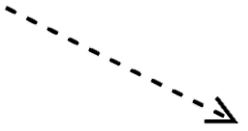

TIFC app inputs
Number of cameras
Length of deployment (days)
Lure (yes/no)
Species of interest (or maybe rare/medium/common)
Number of treatments of interest

Slide 8
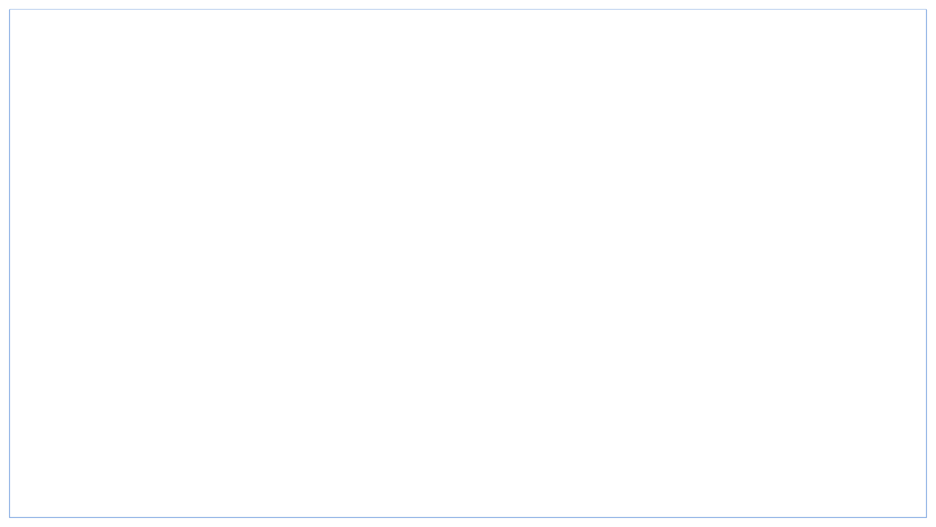
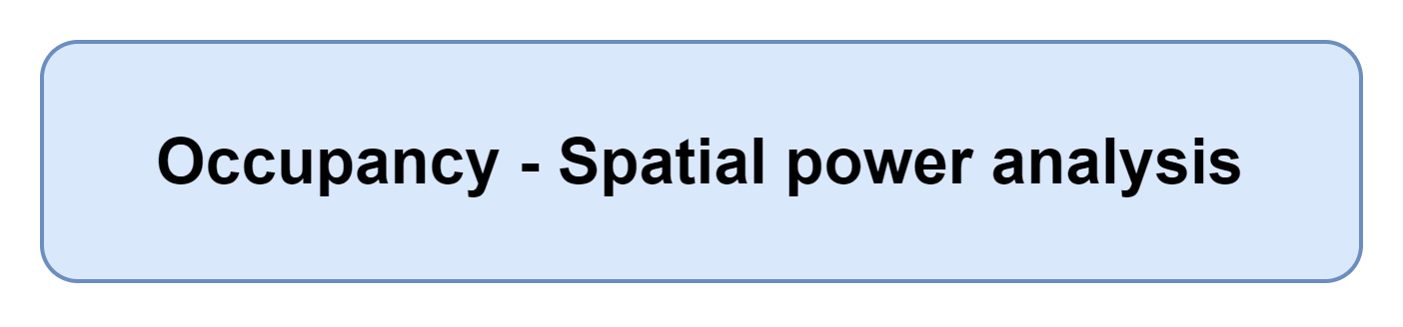
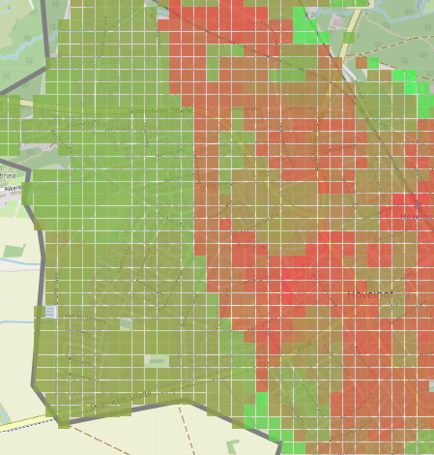

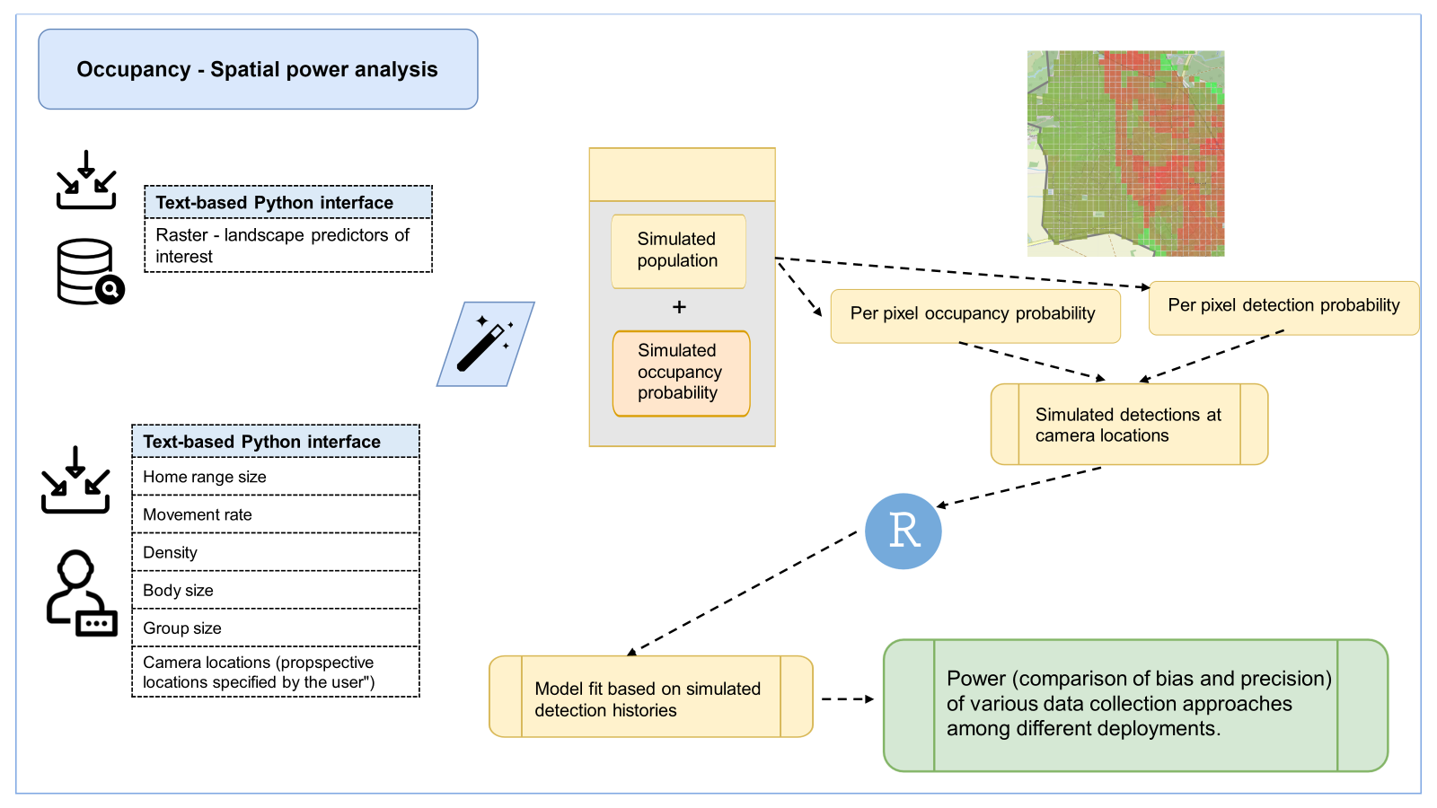
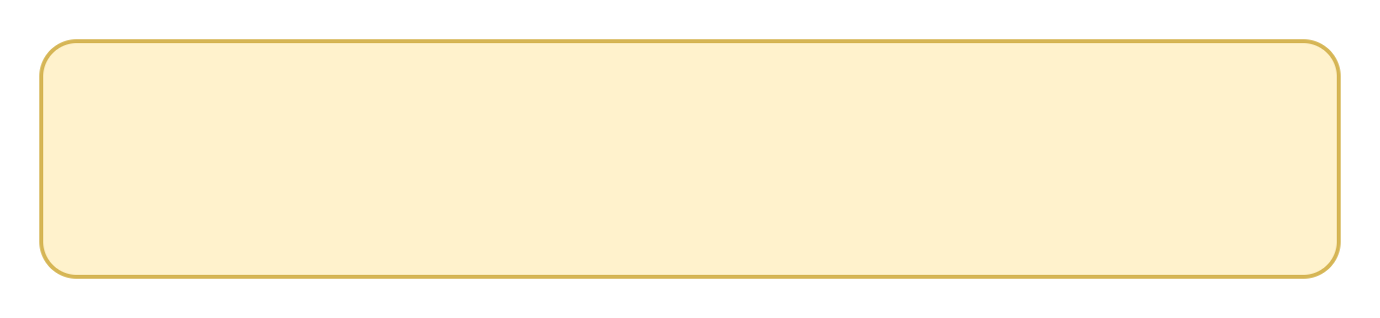


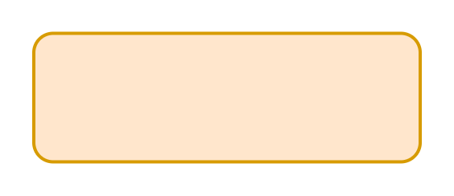
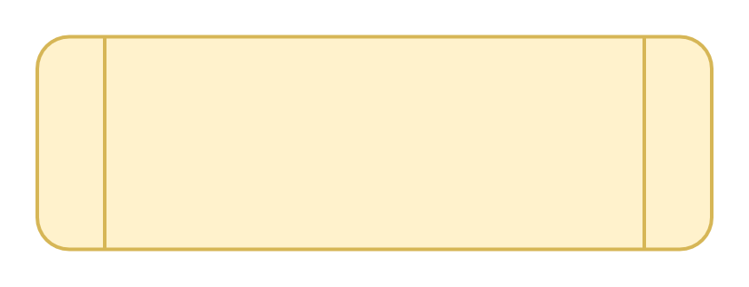

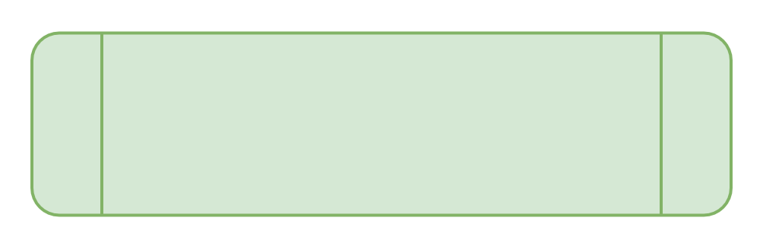
Text-based Python interface
Raster - landscape predictors of interest
Simulated population
+
Per pixel occupancy probability
Per pixel detection probability
Simulated occupancy probability
Simulated detections at camera locations
Text-based Python interface
Home range size
Movement rate
Density
Body size
Group size
Camera locations (propspective locations specified by the user")
Model fit based on simulated detection histories
Power (comparison of bias and precision) of various data collection approaches among different deployments.

Slide 9
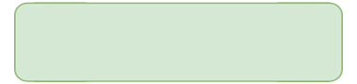
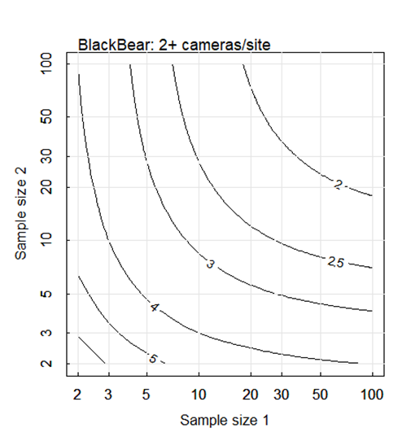
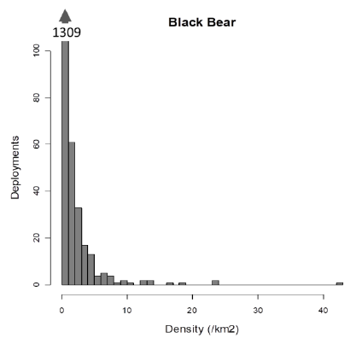
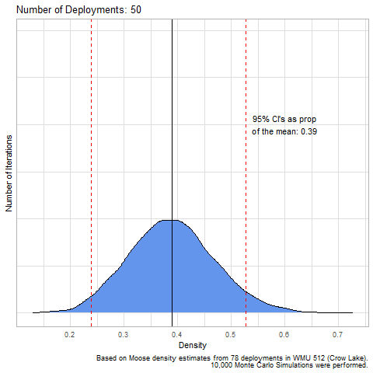
Monte Carlo simulation (10,000 runs) to evaluate expected precision of density estimates
Shiny app outputs
Shiny app user-inputs
Number of cameras
Length of deployment (days)
Lure (yes/no)
Rare/medium/common (with examples) species of interest
Number of treatments of interest
Game trail vs random deployment
Figure of distribution of simulated animal densities (bar chart)
Expected precision of design based on inputs
Figures of expected precision given the number of treatments and cameras

Slide 10
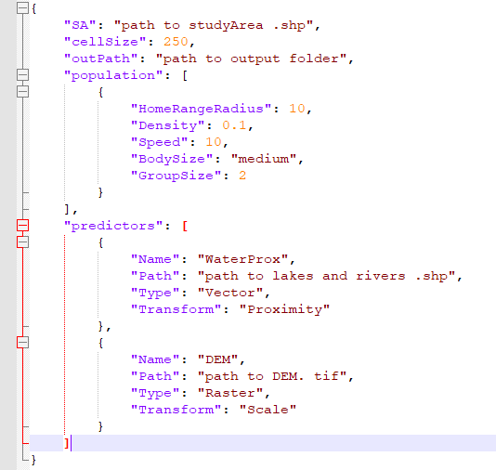
Text-based Python interface
Landscape Drivers of Use (.shp/.tif)
Home range centers
Text-based Python interface
Home range size (radius (m))
Movement rate (m/s)
Density (count/m2)
Body size (small/medium/large)
Group size (count)

Slide 11

Simulate agents moving
Fit occupancy model based on simulated detection histories
Text-based Python interface
Landscape Drivers of Use (.shp/.tif)
Home range centers
Simulated detection history at camera locations
Text-based Python interface
Home range size (radius (m))
Movement rate (m/s)
Density (count/m2)
Body size (small/medium/large)
Group size (count)
Estimate bias (compared to ‘real’ occupancy and detectability) and precision of various data collection approaches among different deployments.
Simulate ’real’ probability of occupancy and detection across landscape

Slide 12
Simulate agents moving
Fit occupancy model based on simulated detection histories
Text-based Python interface
Landscape Drivers of Use (.shp/.tif)
Home range centers
Simulated detection history at camera locations
- Movement rate informed by body size + diet vs ungulate (+ others). Build out use cases after that. 2-3 buckets of speed ---
Text-based Python interface
Home range size (radius (m))
Movement rate (m/s)
Density (count/m2)
Body size (small/medium/large)
Group size (count)
Estimate bias (compared to ‘real’ occupancy and detectability) and precision of various data collection approaches among different deployments.
Simulate ’real’ probability of occupancy and detection across landscape

Slide 13
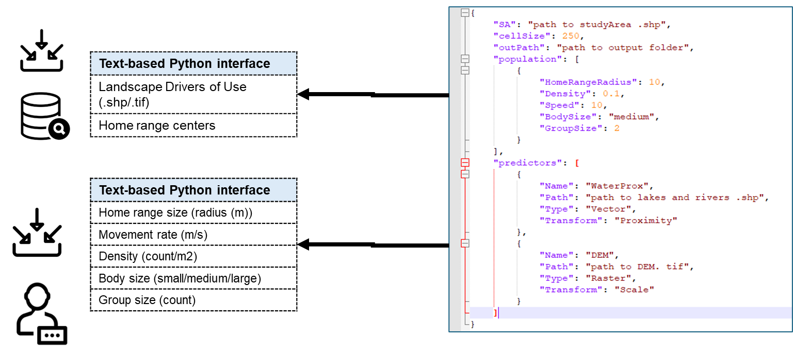
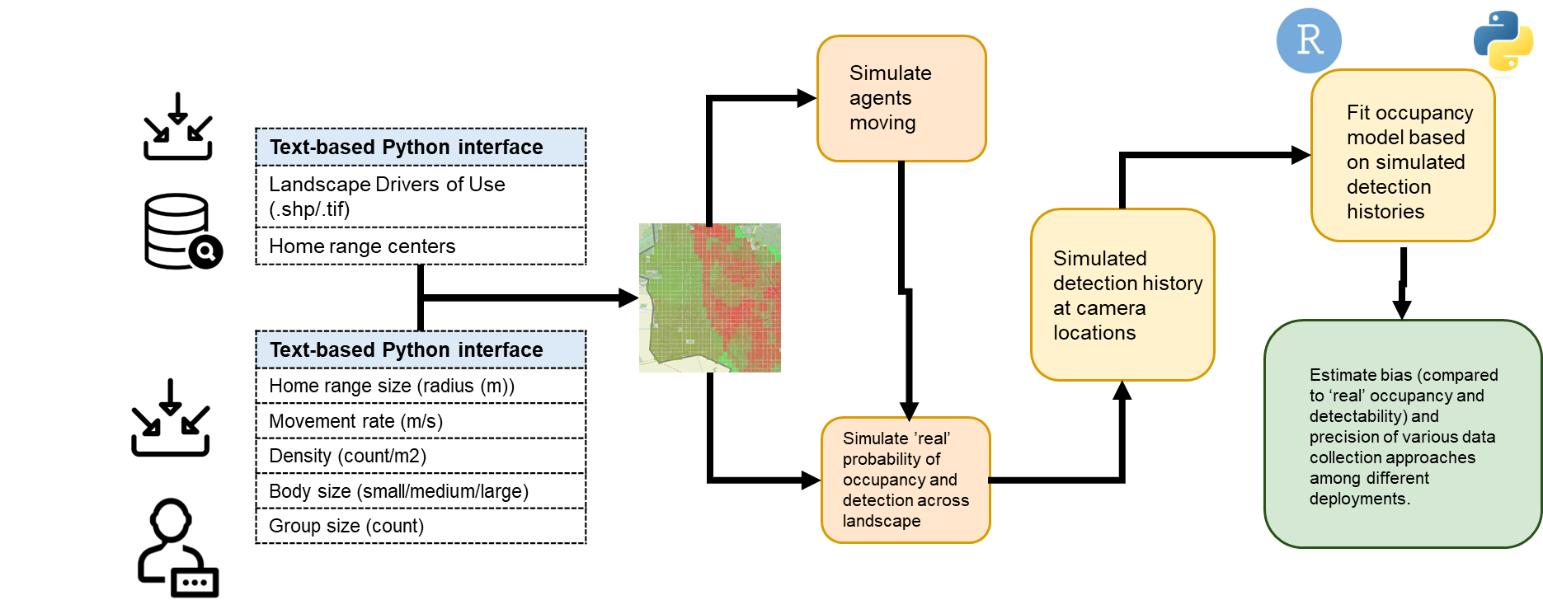

Slide 14











Slide 15


Alberta Environment and Protected Areas & Office of the Chief Scientist
Notes:
I’d like to finish by thanking our funders the Alberta Conservation Association (ACA) AND
the Office of the Chief Scientist (AEPA).
and in-kind supporting agencies and collaborators,:
the Alberta Remote Camera Steering Committee (RCSC), Wildlife Cameras for Adaptive Management (WildCAM) Advisory Committee, Alberta Environment and Protection Areas (AEPA),
Alberta Biodiversity Monitoring Institute (ABMI) and the University of Alberta Faculty of Science
as well as for your time and attention.
We have some time now for a few questions
If anyone has any further questions afterwards, feel free to send me an email.

Slide 16


Slide 17
Alberta Environment and Protected Areas & Office of the Chief Scientist

Slide 21
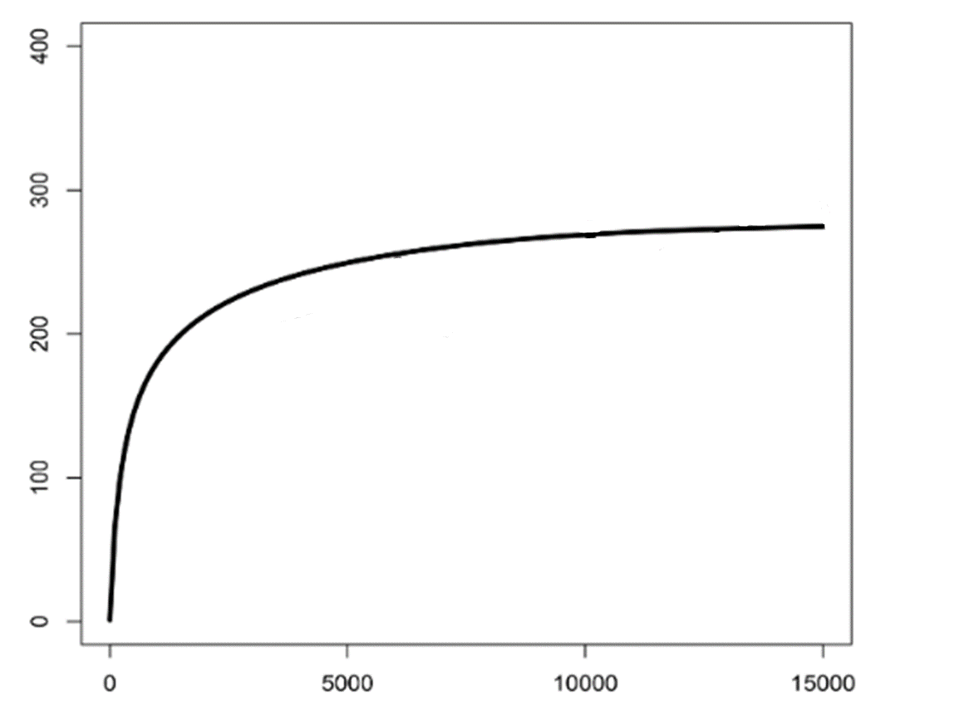
Can be thought of as a “rate” → # new species / time sampled
If this line completely flattens out, you’ve detected all of the species present
Cumulative number of species
Number of individuals caught

Slide 22
FIG_obj_state_var
Objectives
The specific objectives of each survey within a project, including
the Target Species,
the state variables (e.g., occupancy, density), and
proposed modelling approach(es).
Survey Objectives should be specific, measurable, achievable, relevant, and time-bound (i.e., SMART).
State variable
A formal measure that summarizes the state of a community or population at a particular time (Wearn & Glover-Kapfer, 2017)
For example
If the objective is “to monitor trends in wolf occupancy at 5-year intervals from January – December 2020 to 2023."
The state variable is "occupancy"

Slide 23
FIG_obj_state_var
Objectives
The objectives of each survey within a project, should include
Target Species: the species the survey is designed to detect (e.g., moose)
state variable(s), and
proposed modelling approach(es)
Target Species
The species the survey is designed to detect (e.g., moose)
State variable
A measure of the state of the species community or population at a particular time (Wearn & Glover-Kapfer, 2017)
(e.g., moose)
For example
If the objective is “to monitor trends in wolf occupancy at 5-year intervals from January – December 2020 to 2023."
The state variable is "occupancy"

Slide 24
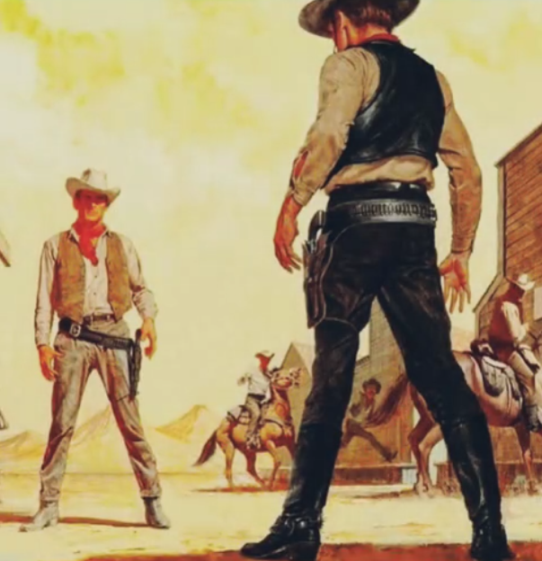
It’s the study design wild west out here

Slide 25
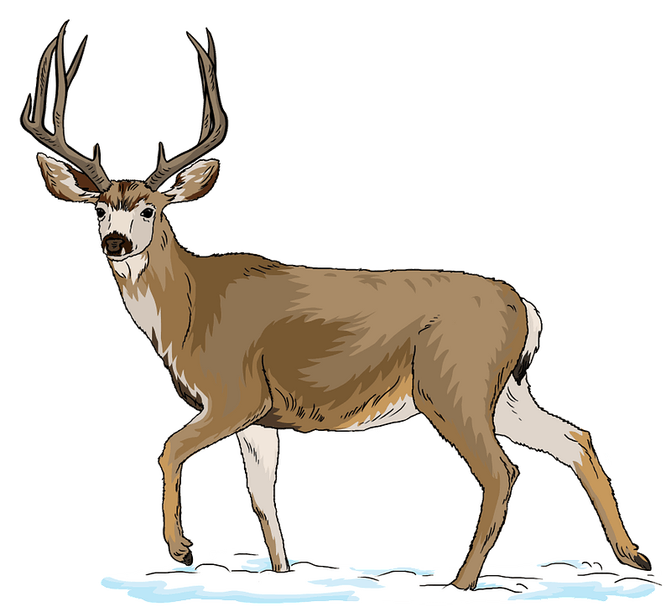
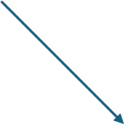
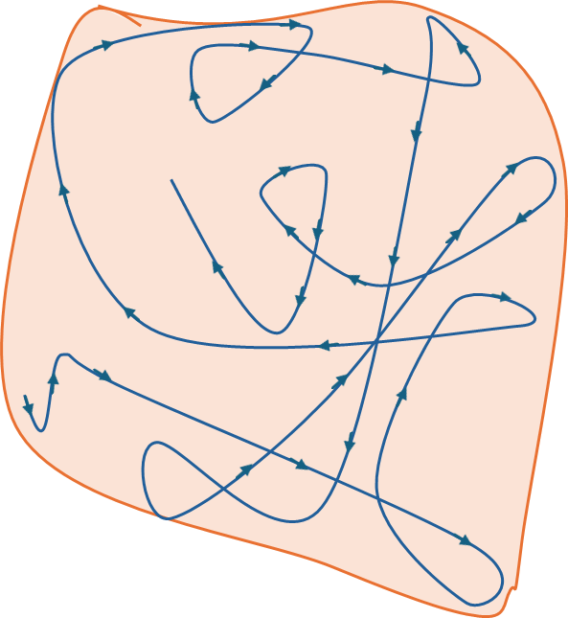

Slide 27
